Slide 1
IoT Based Garage Door Opener- Zero PCB Implementation Part-1
Shivinder Kaur (C0751078)
Group 4

Slide 2
Content:
Introduction to PCB
Types of PCBs
Zero PCB
Introduction to Soldering
Steps for Soldering
Soldering a Circuit Board
Schematic of Project
PCB Design of Project
Requirements

Slide 3
Content:
Top View of PCB
Bottom View of PCB
Connections Beaglebone Black and IR Sensors
Connections of BBB and Buzzer
BBB and LEDs
BBB and Wifi Module
BBB and Limit Switches
Testing Continuity
References

Slide 4
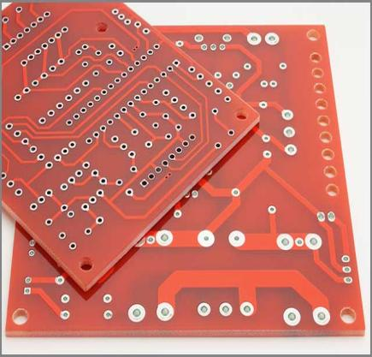
Introduction to PCB:
A printed circuit board (PCB) mechanically supports and electrically connects electrical or electronic components using conductive tracks, pads and other features etched from one or more sheet layers of copper laminated onto and/or between sheet layers of a non-conductive substrate.
Components are generally soldered onto the PCB to both electrically connect and mechanically fasten them to it.

Slide 5
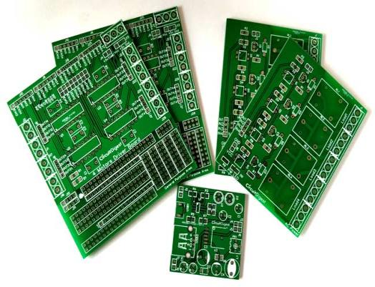
Types of PCBs:
Single sided PCBs
Double sided PCBs
Multilayer PCBs
Rigid PCBs
Flex PCBs
Rigid-Flex PCBs
High Frequency PCBs
Aluminium Backed PCBs
Zero PCBs

Slide 6
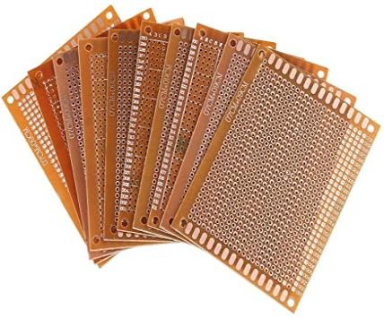
Zero PCBs:
Zero PCB is basically a general-purpose printed circuit board (PCB), also known as perfboard or DOT PCB.
It is a thin rigid copper sheet with holes pre-drilled at standard intervals across a grid with 2.54mm (0.1- inch) spacing between holes.

Slide 7
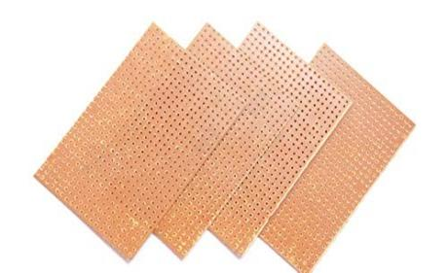
Zero PCBs:
Each hole is encircled by a round or square copper pad so that component lead can be inserted into the hole and soldered around the pad without short-circuiting the nearby pads and other leads.
For connecting the lead of component with another lead, solder these together or join these using a suitable conducting wire.

Slide 8
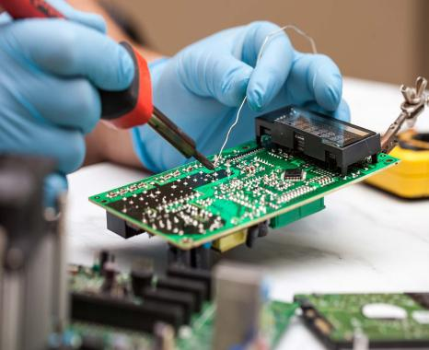
Introduction to Soldering:
Soldering is a joining process used to join different types of metals or components by melting solder.
Solder is a metal alloy usually made of tin and lead which is melted using a hot iron. The iron is heated to temperatures above 600 fahrenheit which then cools to create a strong electrical bond.

Slide 9
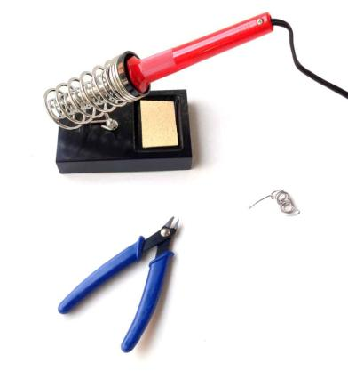
Steps for Soldering:
Prepare your workbench: Prepare your workspace. Find your soldering iron and your solder wire and then start heating the soldering iron. Also, place your soldering in a holder when not in use.
Clean the tip: When the iron is hot, the first thing you should is to clean the tip to remove the old solder from it. You can use a wet sponge, a copper scouring pad or something similar.
Tin the tip: Before you start soldering, you should tin the tip of the soldering iron. Which just means to melt some new solder onto the tip. This makes the tip transfer heat faster and thereby making the soldering easier and faster.

Slide 10
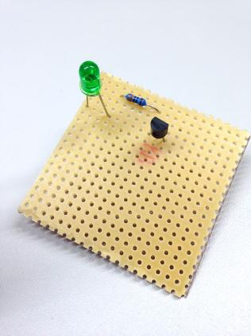
Soldering a Circuit Board:
Component Placement: After the component and board have been cleaned, you are ready to place the components onto the board. Unless you circuit is quite simple and only contains a few components, you will probably not be placing all the components onto the board and solder them at once. Most likely you will be soldering a few components at a time before turning the board over and placing more. In general it is best to start with the smallest and flattest components and then work up to the larger components after the small parts are done.
Apply Heat: Apply a small amount of solder to the tip of the iron. This helps conduct the heat to the component and board, but it is not the solder that will make up the joint. To heat the joint you will lay the tip of the iron so that it rests against both the component lead and board.

Slide 11
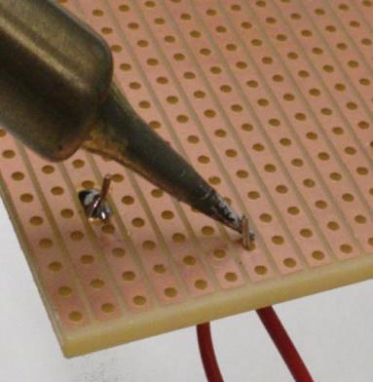
Soldering a Circuit Board:
Apply Solder to the Joint: Once the component lead and solder pad has heated up, you are ready to apply the solder. Touch the tip of the strand of solder to the component lead and solder pad, but not the tip of iron. If everything is hot enough, the solder should flow freely around the lead and pad.
Inspect the Joint and Cleanup: Once the joint is made you should inspect it. Check for the cold joints, shorts with adjacent pads or poor flow. If the joint checks out, move on to the next. To trim the lead, use a small set of side cutters and cut the top of the solder joint.

Slide 12
Schematic of Project:

Slide 13
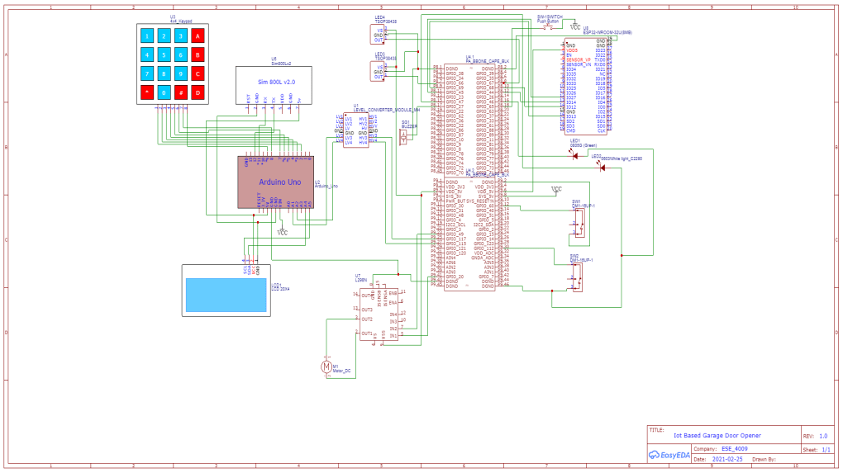

Slide 14
PCB Design of Project:

Slide 15
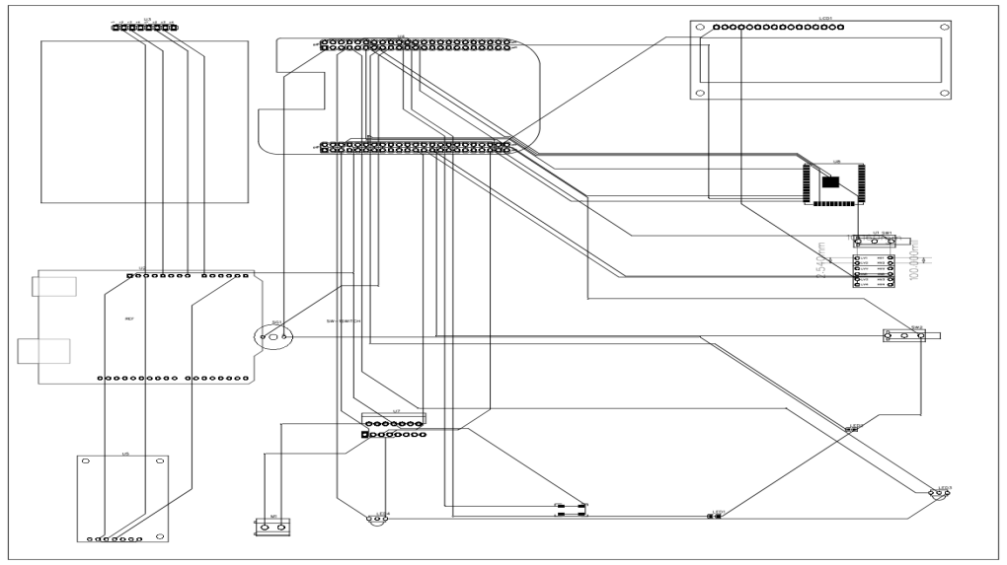

Slide 16
Requirements:
Zero PCB
Soldering Iron
Soldering Wire
Jumper or Hookup Wires
Headers
Multimeter

Slide 17
Requirements:
Beaglebone Black
ESP32 Wifi Module
IR Sensor
Buzzer
LEDs (Green and Red)
Limit Switches

Slide 18
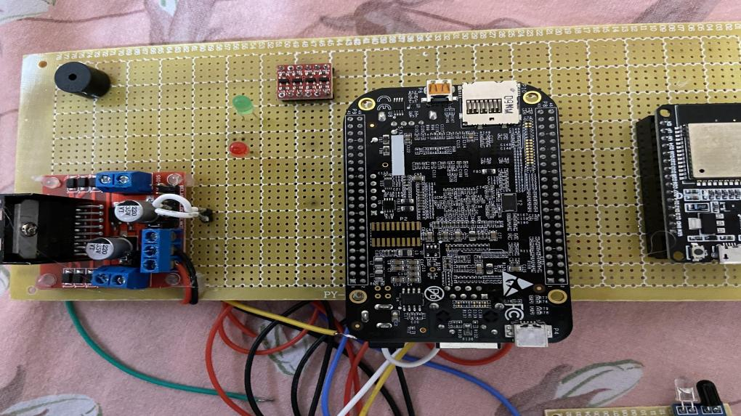
Top View of PCB:

Slide 19
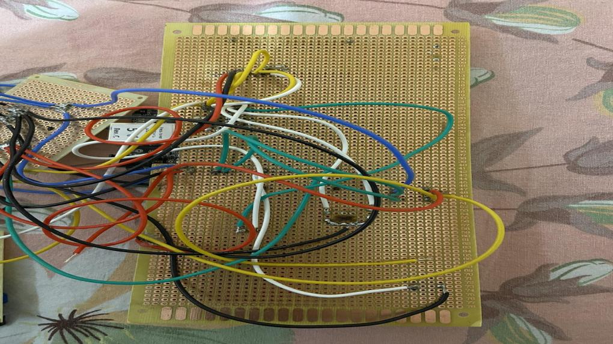
Bottom view of PCB:

Slide 20
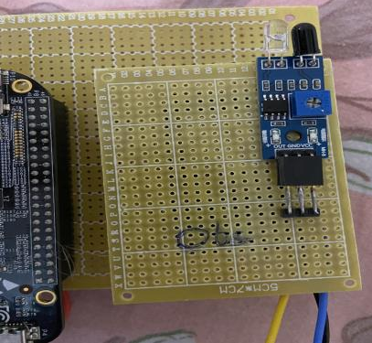
Connections of Beaglebone Black and IR Sensor:
The output pin of IR Sensor to detect the obstacle has been connected to pin 7 of port 8 of Beaglebone Black.
3.3V power has been given to both the sensors and grounds has been given to the ground pin.

Slide 21
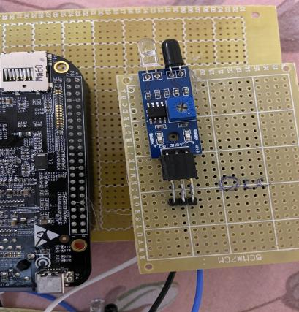
Connections of Beaglebone Black and IR Sensors:
The output pin of IR Sensor to detect the occupancy of the garage has been connected to pin 8 of port 8 of Beaglebone Black.
3.3V power has been given to both the sensors and grounds has been given to the ground pin.

Slide 22
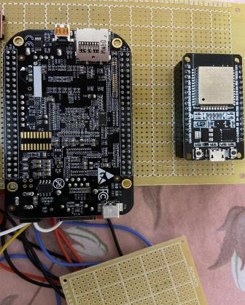
Connections of BBB and ESP32 Wifi Module:
Pin 14 of ESP 32 has been connected to pin 14 of port 8 of Beaglebone Black. This pin is used to open the door from webpage.
Pin 27 of ESP 32 is connected to pin 11 of port 8 of Beaglebone Black to close the door from webpage.
Pin 13 of ESP 32 is connected to pin 10 of port 8 of Beaglebone Black to indicate the status of garage door.
3.3 V power and ground

Slide 23
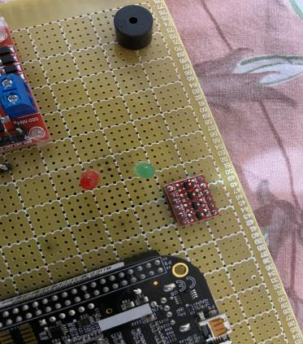
Connections of BBB and Buzzer:
The positive pin of Buzzer has been connected to pin 23 of port 9 of Beaglebone Black.
The negative pin of buzzer has been given to ground.

Slide 24
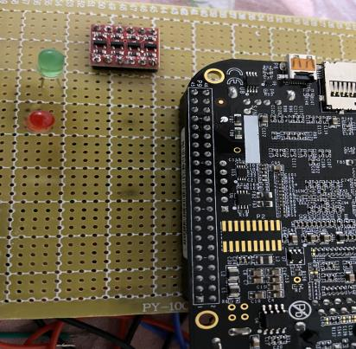
Connections of BBB and LEDs:
The positive pin of Green LED has been connected to pin 16 of port 8 of Beaglebone Black.
The positive pin Red LED has been connected to pin 15 of port 8 of Beaglebone BLack.
The negative pins of both LEDs has been given to ground pin.

Slide 25
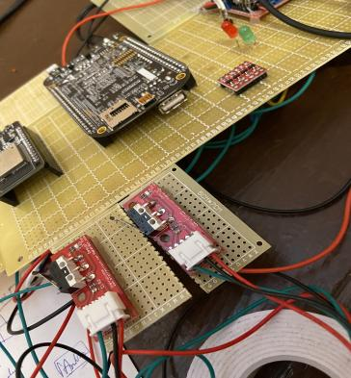
Connections of BBB and Limit Switches:
Limit Switch 1 has been connected to pin 12 of port 9 of Beaglebone Black.
Limit Switch 2 has been connected to pin 30 of port 9 of Beaglebone Black.
And then ground has been provided to both the switches.

Slide 26
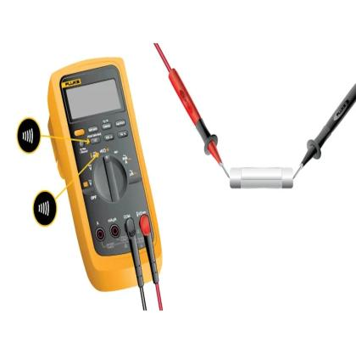
Testing Continuity:
Continuity is the presence of a complete path for current flow. A circuit is complete when its switch is closed.
A digital multimeter’s Continuity Test mode can be used to test switches, fuses, electrical connections, conductors and other components. A good fuse, for example, should have continuity.
A DMM emits an audible response (a beep) when it detects a complete path.
The beep, an audible indicator, permits technicians to focus on testing procedures without looking at the multimeter display.

Slide 27
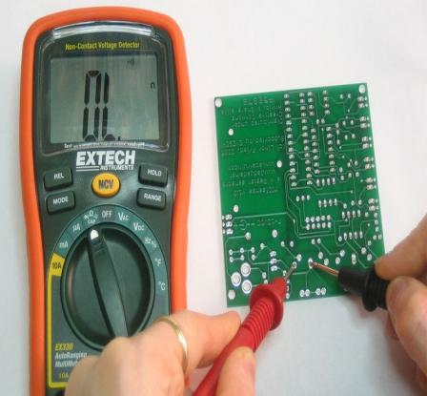
Testing Continuity:
Turn the dial to Continuity Test Mode. It will likely share a spot on the dial with one or more functions, usually resistance. With the test probes separated, the multimeter’s display may show OL and Ω.
If required, press the continuity button.
First insert the black test lead into the COM jack. Then insert the red lead into the VΩ jack. When finished, remove the leads in reverse order; red first, then black.

Slide 28
Testing Continuity:
4.With the circuit de-energized, connect the test leads across the component being tested. The position of the test leads is arbitrary. Note that the component may need to be isolated from other components in the circuit.
5. The digital multimeter DMM beeps if a complete path (continuity) is detected. If the circuit is open (the switch is in off position), the DMM will not beep.
6. When finished, turn the multimeter OFF to preserve battery life.

Slide 29
References:
PCB : Retrieved from en.wikipedia.org, URL: https://en.wikipedia.org/wiki/Printed_circuit_board
Types of PCB: Retrieved from theengineersprojects.com, URL: https://www.theengineeringprojects.com/2018/03/different-types-of-pcb-printed-circuit-board.html
Zero PCB: Retrieved from electronicsforu.com, URL: https://www.electronicsforu.com/technology-trends/learn-electronics/veroboard-zero-pcb-difference
Soldering: Retrieved from twi-global.com, URL: https://www.twi-global.com/technical-knowledge/faqs/what-is-soldering#:~:text=Soldering%20is%20a%20joining%20process,create%20a%20strong%20electrical%20bond.

Slide 30
References:
Soldering: Retrieved from instructables.com, URL: https://www.instructables.com/Simple-PCB-soldering/
How to solder: Retrieved from build-electronic-circuits.com, URL: https://www.build-electronic-circuits.com/how-to-solder/
Testing Continuity: Retrieved from fluke.com, URL: https://www.fluke.com/en-ca/learn/blog/digital-multimeters/how-to-test-for-continuity

